Slide 1
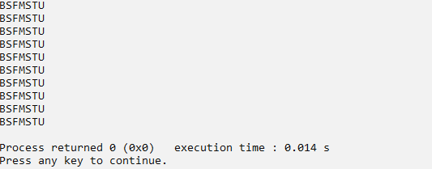
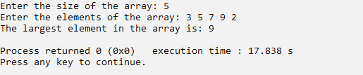

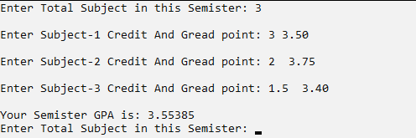

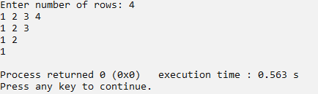
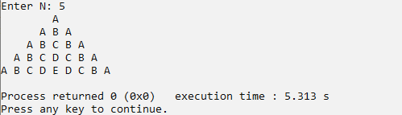

A-Experiment-1 Output:
A-Experiment-2 Output:
A-Experiment-3 Output:
A-Experiment-4 Output:
A-Experiment-5 Output:
A-Experiment-6 Output:
A-Experiment-7 Output:
B-Experiment-1 Output:

Slide 2




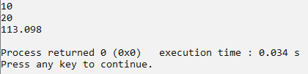
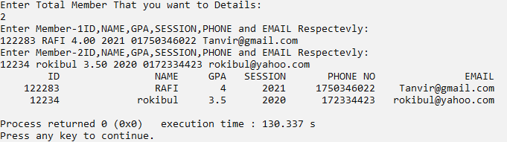
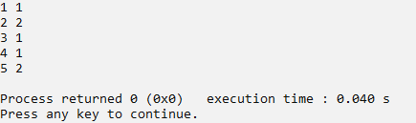

B-Experiment-2 Output:
B-Experiment-3 Output:
B-Experiment-4 Output:
B-Experiment-5 Output:
B-Experiment-6 Output:
B-Experiment-7 Output:
B-Experiment-8 Output:
B-Experiment-8 Output:
Rafi

